Slide 1
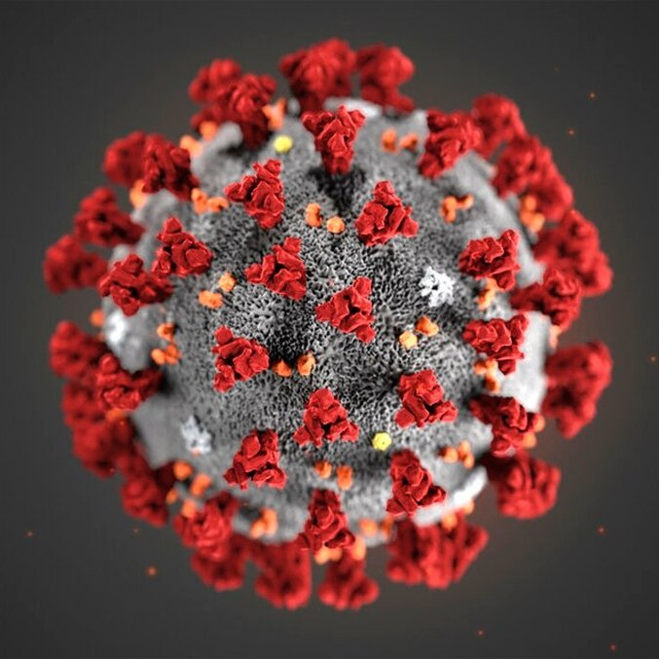
NJ AIDD Network Virtual Town Hall Convening the DD Community in the time of COVID-19
Reopening and Reimagining Part II:
Striving for the Ideal
6/25/2020
Notes:
Please join Disability Rights New Jersey and our Developmental Disabilities Network partners, The New Jersey Council on Developmental Disabilities and the Elizabeth M. Boggs Center on Developmental Disabilities, along with invited guests from the Office of the Ombudsman for Individuals with Developmental Disabilities and their families, as we host a virtual listening session this Thursday April 2 from 7pm-8pm.
We are offering this as an opportunity for individuals and family members to connect with us and one another, and promote the sharing of resources, information, and experiences. We will also provide brief updates on the continued work of our agencies in these constantly changing times.
You may send questions in advance to questions@drnj.org. (Please note that this email is specifically for questions/comments for our listening session. Any priority issues that would normally go through our intake process should still be directed to advocate@drnj.org)
Registration:
Please Register via this Zoom link. Only the first 100 participants will be able to access the live event but we will record the session and provide access to everyone who registers after the event.

Slide 2
Sheltered Workshops Survey
Disability Rights New Jersey seeks information and experiences of workshop participants while COVID-19 caused workshops to be closed.
We encourage any workshop participants, family and workshop staff to share your thoughts and experiences while home and not attending workshops.
Contact us today at advocate@drnj.org
Notes:
Content Slide Option #3 – Use this slide for the content of your presentation. Duplicate as needed
<number>

Slide 3
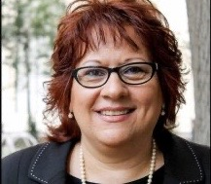
Mercedes Witowsky
Executive Director
njcdd@njcdd.org
Advocate
Collaborate
Educate
Notes:
Introduce your self and your role at the Council
<number>

Slide 4
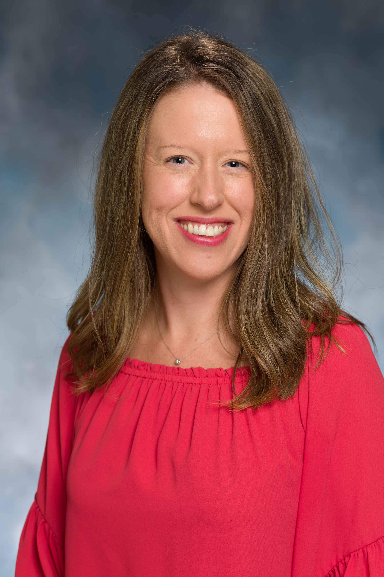
The Boggs Center on Developmental Disabilities
Colleen A. McLaughlin
Associate Director

Slide 5
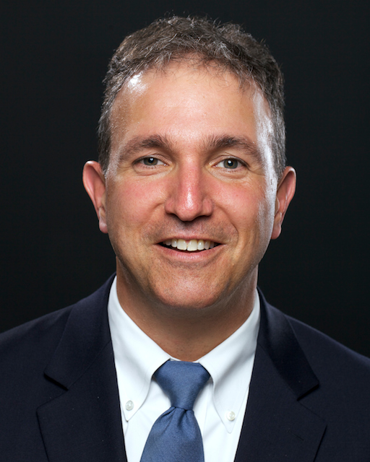
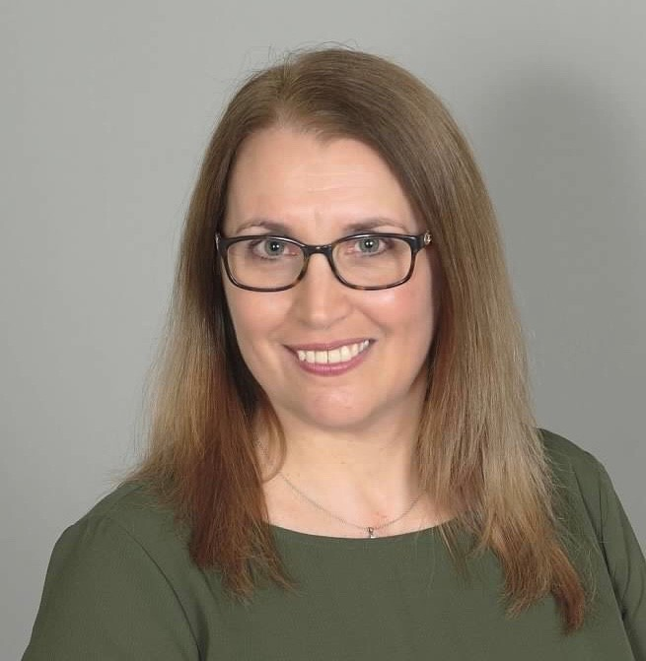
Office of the Ombudsman for Individuals with Intellectual or Developmental Disabilities and Their Families
Paul Aronsohn Christine Bakter
Ombudsman Associate Directorpaul.aronsohn@treas.nj.gov christine.bakter@treas.nj.gov 201.213.1811 (personal cell) 609.789.6022 (cell)

Slide 6
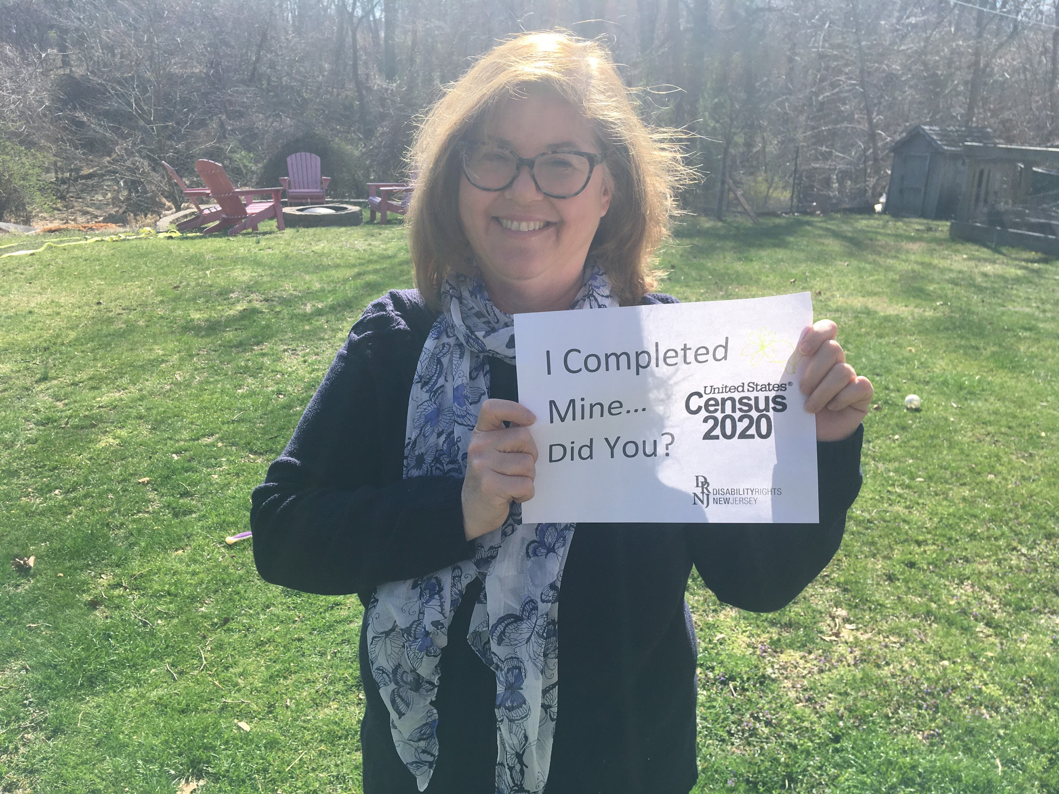
Contact Us:
210 South Broad Street, 3rd Floor
Trenton, New Jersey 08608
800-922-7233 (toll free in NJ only)
609-292-9742
609-777-0187 FAX or 609-633-7106 TTY
www.drnj.org
Gwen Orlowski
Executive Director

Slide 7
We want to hear from you!
Share questions in the Chat window

Slide 8
We want to hear from you!
Share questions via email or text!
Email or Text Your Questions:
Questions@drnj.org
Notes:
Add phone icon

Slide 9
Mercedes Witowsky
Executive Director
njcdd@njcdd.org
Advocate
Collaborate
Educate
Notes:
Introduce your self and your role at the Council
<number>

Slide 10
Recap: DDD Re-Opening Workgroup
DHS/DDD has convened a workgroup to discuss re-opening of congregate day programs and other areas.
First meeting was June 4, 2020.
Charge is to develop recommendations and guidelines that can be used by individuals, families and agencies to inform re-opening.

Slide 11
Recommendations/Guidelines for:
The Now
Pre-Opening
Soft Opening
Ramp up and moving to full capacity
Adjusting back based on data

Slide 12
Re-Opening Workgroup Membership
Five Service Providers
Laura Williams - Arc of Ocean County
Providing Day Facility based and Community Day Hab; Supported Employment; In-home services; Residential and Services; Support Coordination.
Svetlana Repic-Qira - Community Options
Providing Facility based and Community Based Day Hab; Employment services; In-home services; Residential Services and Medically fragile day programs.
3) Joanna Miller - Department for Persons with Disabilities
Day Services – Facility based; Residential Services; Support Coordination.
4) David Mock - PrimeTime Centers
Day Only Provider – Facility based and Community Based Day Hab; Pre-Vocational Services.
5) Reggie Neal - United Cerebral Palsy Hudson County
Day Only Provider – Facility Based; Special Needs; Aftercare Respite; In-home respite

Slide 13
Re-Opening Workgroup Membership
Five Advocates
Margaret Gilbride - The Boggs Center on Developmental Disabilities
Eileen Hurley – Family member; Chair of DDD Family Advisory Council; Chair of Regional Family Support Planning Councils.
Carolyn Hayer - Family member; DDD Family Advisory Council member; State Rehabilitation Council member; SPAN - NJ’s federally funded parent training & information center;
Board Member of DRNJ & The Arc of NJ.
4) Renee Pierce - Self-Advocate who receives services from an impacted agency.
5) Mercedes Witowsky – NJ Council on Developmental Disabilities and Family Member

Slide 14
COVID-19 Reopening Concerns:
Ability to wear and remove cloth masks
Transportation
Needs and Risks
Holding ‘spots’ in day and residential services
Service Capacity Limitations
Monitoring Risk/Testing Options
Remote/In-Home
Staff Consistency
Notes:
<number>

Slide 15
COVID-19 Reopening Recommendations
Protocols for sanitation, screening, community/outdoor activities, social distancing/space constraints, testing, transportation
Prioritize return based on needs and risks, offer flexibility, maintain small consistent groupings, daily reinforcement of hygiene and social distancing practices
Notes:
<number>

Slide 16
Reimagining:
How can I reimagine?
Is this really the time to reimagine?
Who can help me reimagine?
What are the possibilities?
I just want things to go back to NORMAL!

Slide 17
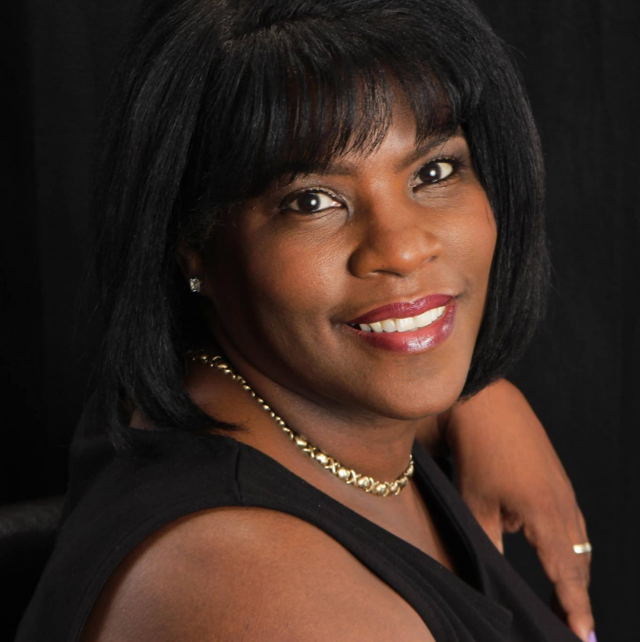
Family Advocate Perspective: Reimagining
Carolyn Hayer

Slide 18
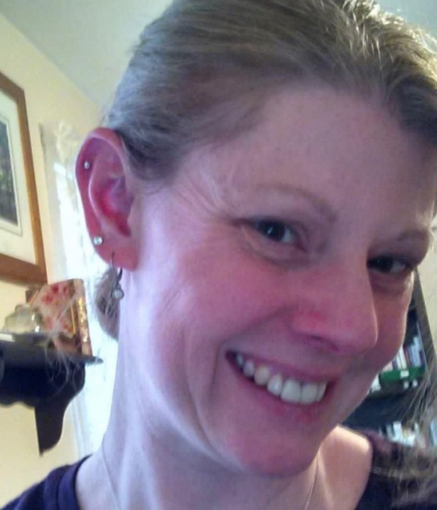
Support Coordinator Perspective: Reimagining
Amy Watts
Contact Amy for a deeper conversation and more information:
amywatts@neighbours-inc.com

Slide 19
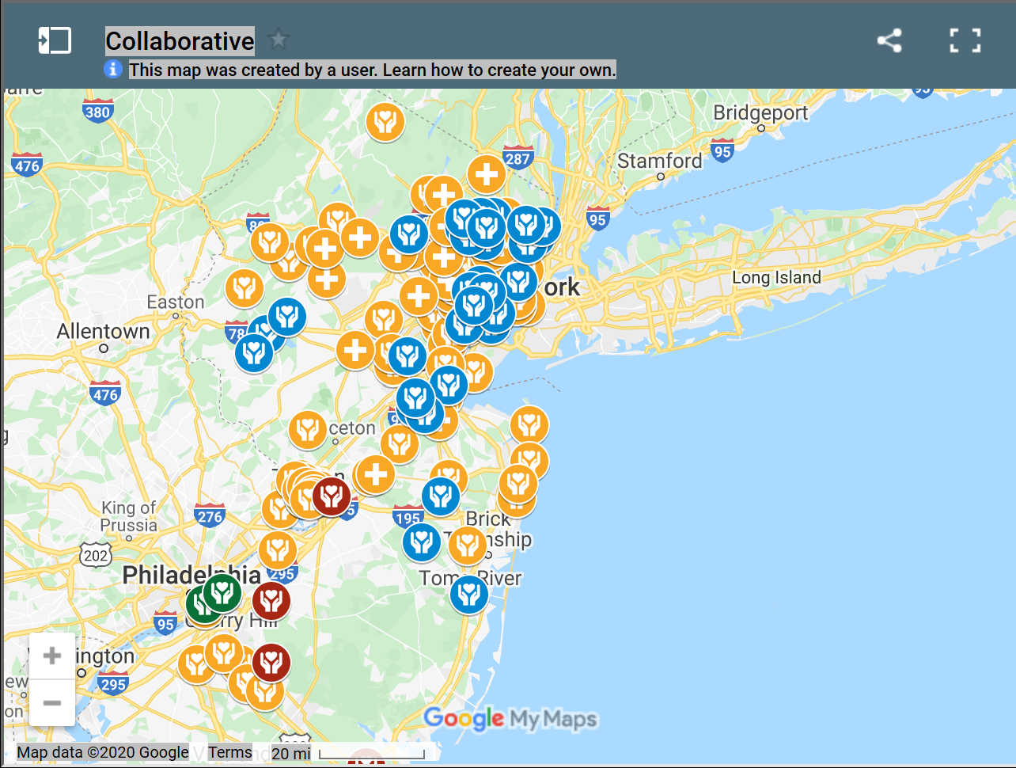
Q: Is the map officially live?
A: Yes! The map can be found here http://www.thecollaborativenj.org/interactive-map.html
Q: How do Direct Support Provider (DSP) agencies post availability?
A: DSP agencies email thecollaborativenj@gmail.com to request participation. To remain in the map database it is necessary to update availability weekly.
Q: How do DSP agencies update availability?
A: Once approved, participants will be able to update availability directly; if the availability has not changed, note this each week so it is clear you wish to remain active in the map database.
Q: How do Self Directed Employees (SDE) post and update availability?
A: Please click on this link to complete a short form with the information for the map tool
Q: How do individuals or their families post needs?
A: Please click on this link to complete a short form with the information for the map tool
Q: How do individuals or their families update their needs?
A: Your listing will remain active until you request us to remove it. If your needs have changed please fill out this form .
Q: Is there any cost for the individual/family to participate?
A: No
Q: How often is the map updated?
A: The map is updated each Friday.
Q: What happens if the DSP/SDE that I contact is not available?
A: The map is updated weekly to ensure it is accurate, please refer back to the map to find another listing.
Q: Who do I contact if I have additional questions?
A: Please email thecollaborativenj@gmail.com . We will make every effort to respond within 48 hours.
Q: I have used the map tool to identify a DSP/SDE to work with me. What are the next steps?
A: Congratulations! Contact your Support Coordinator for next steps.

Slide 20
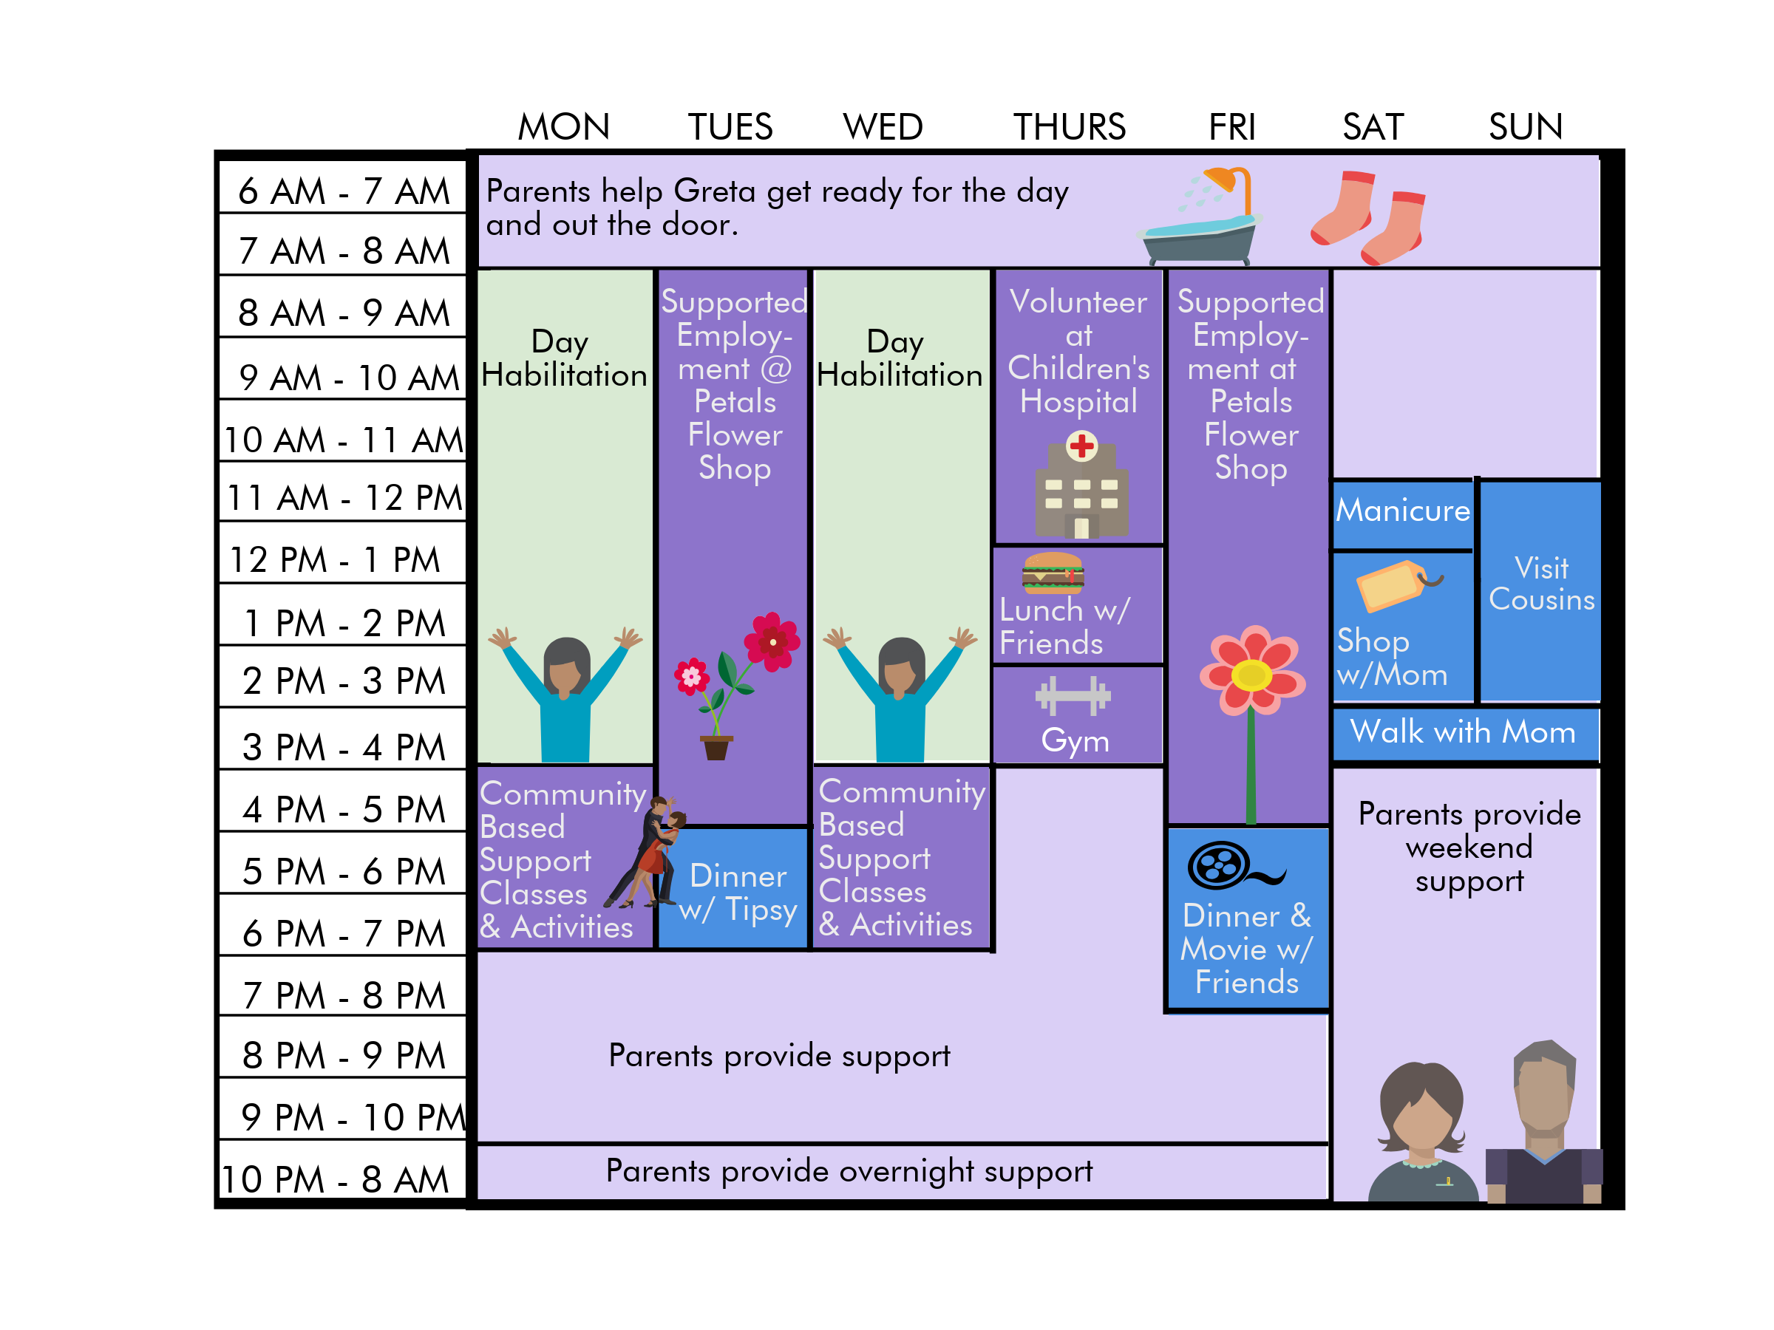
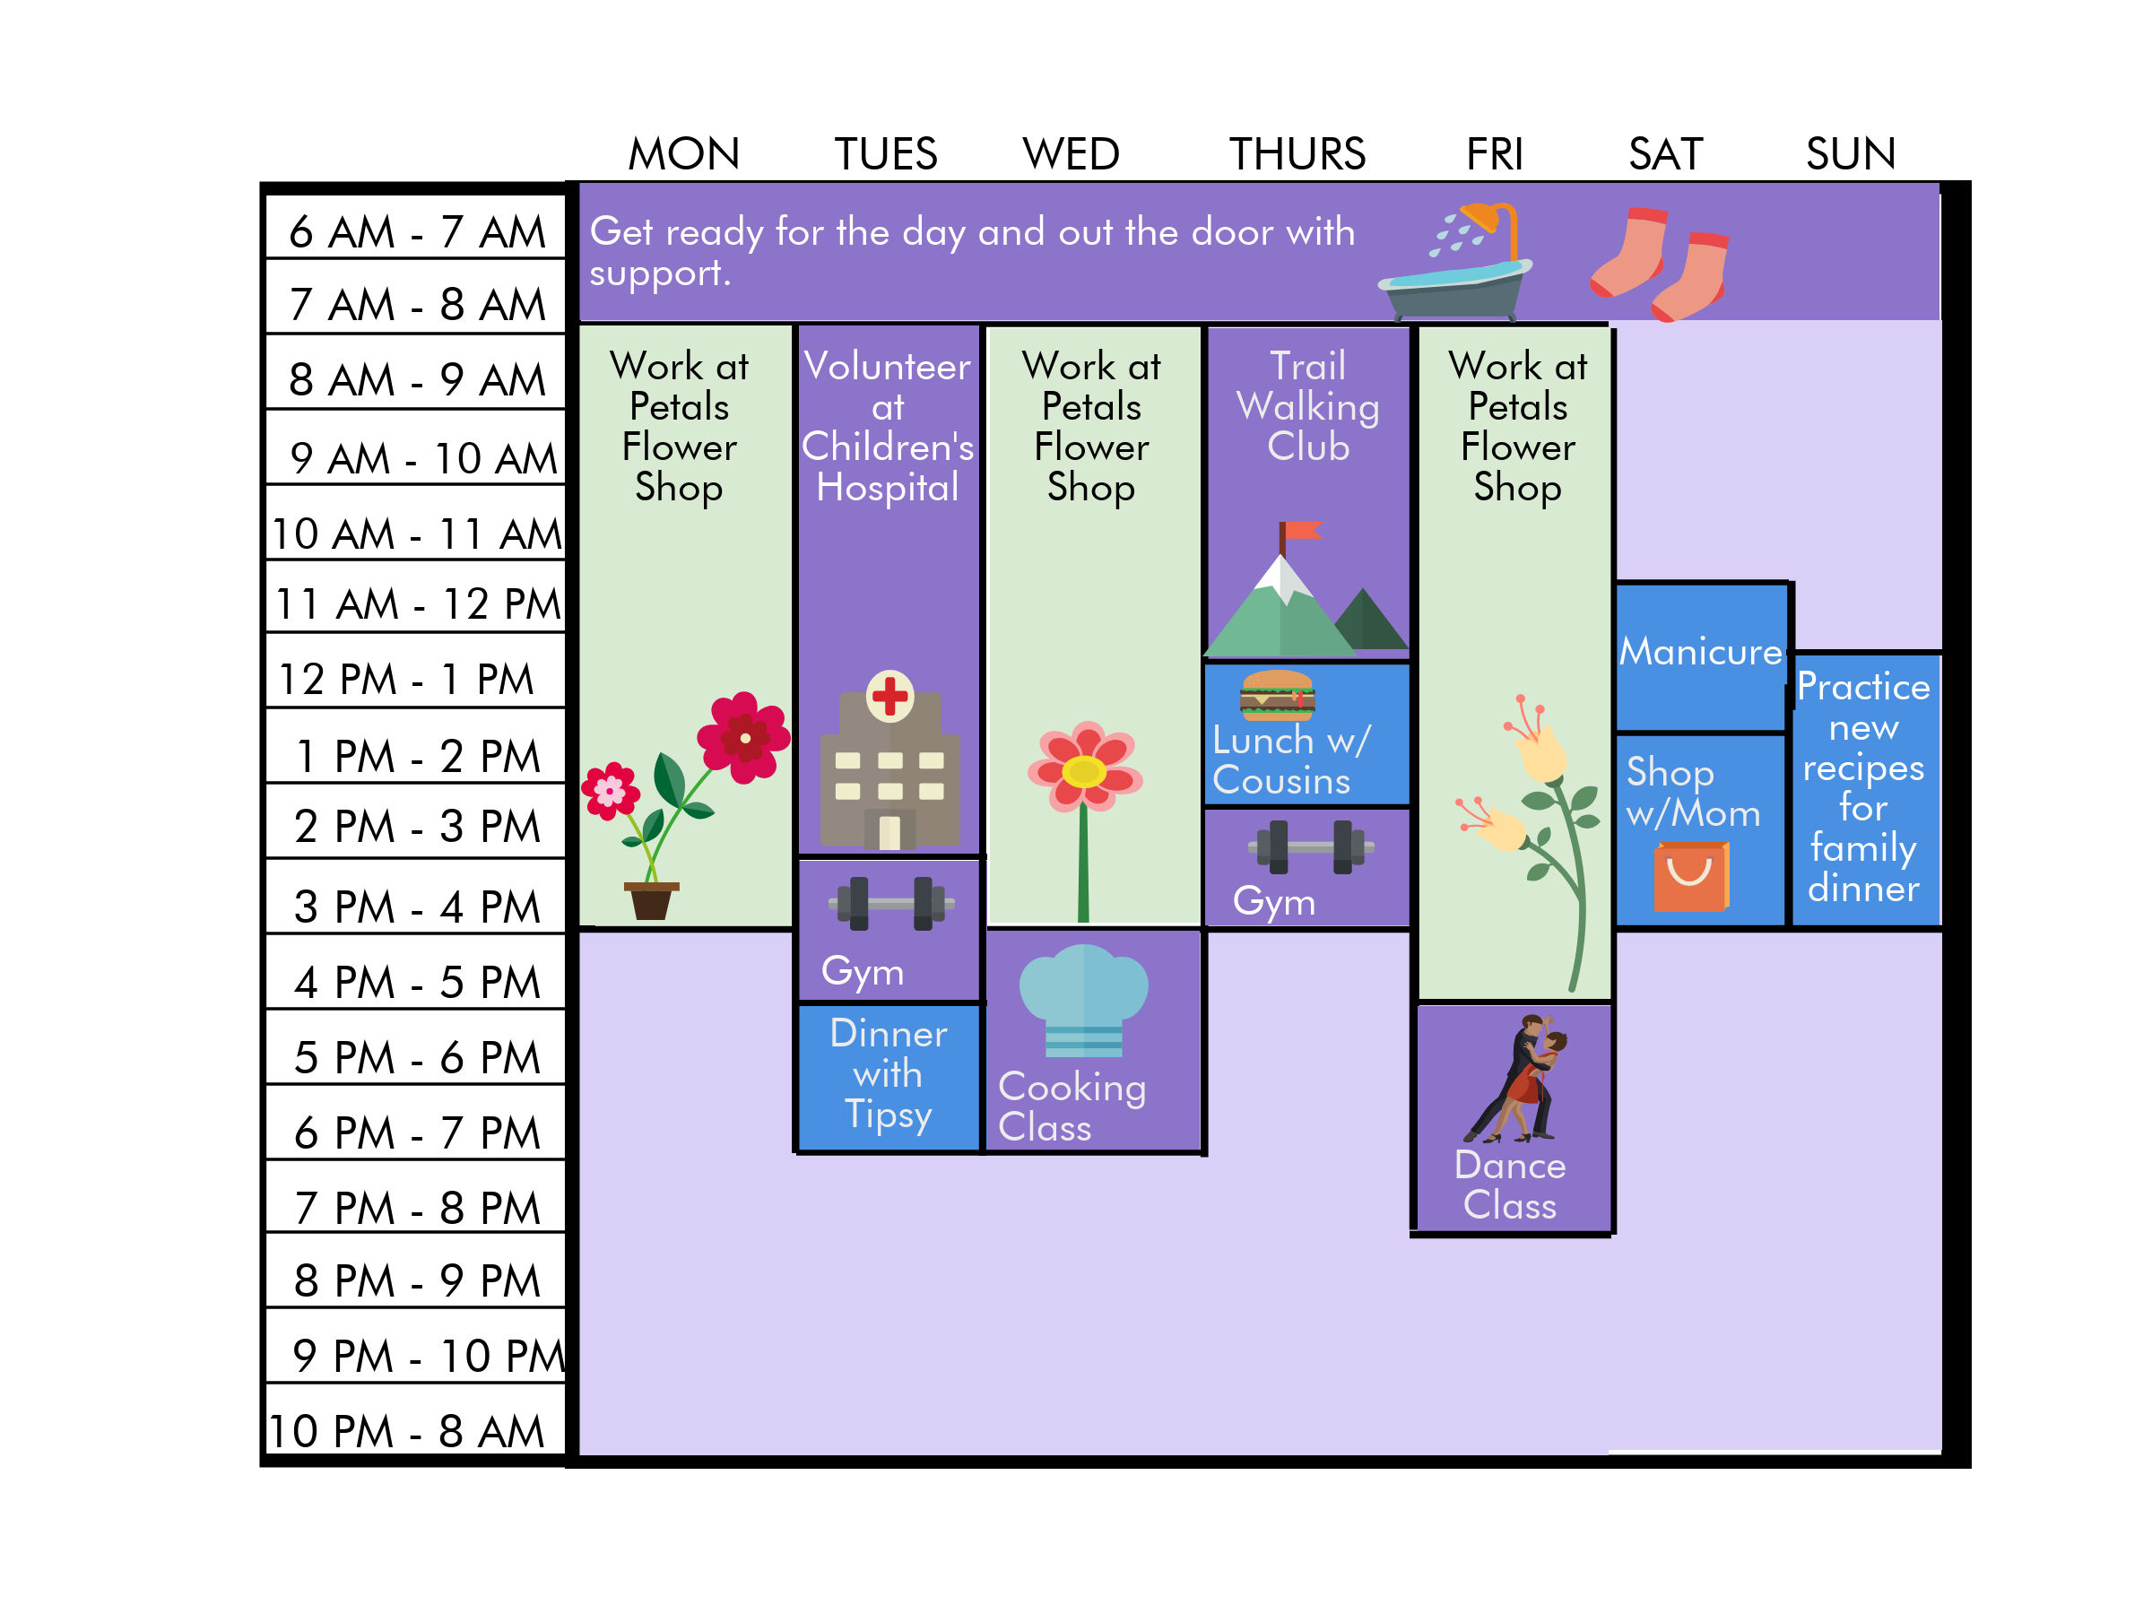
Daily Life Re-Imagined
Notes:
PURPOSE: To introduce “The Blended Week.”
INSTRUCTOR NOTES: The Blended Week combines traditional agency and self-directed models. It makes use of provider agencies for some supports, while incorporating self-directed supports based on the person’s needs, desires, and interests.
See Greta’s blended week. She receives a mixture of day habilitation, supported employment, community-based support classes and activities, volunteering, and free-time activities related to her interests.
<number>

Slide 21
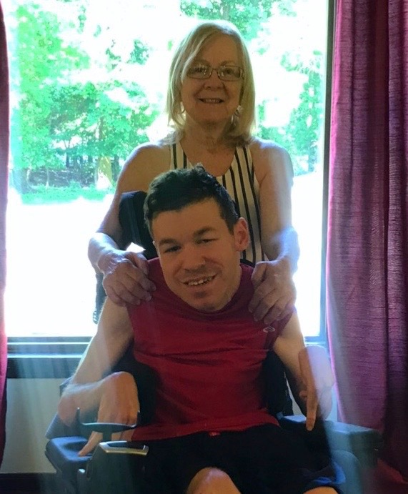
Self Advocate/Family Advocate Perspective: Reimagining
Joey and Ann Martinelli

Slide 22
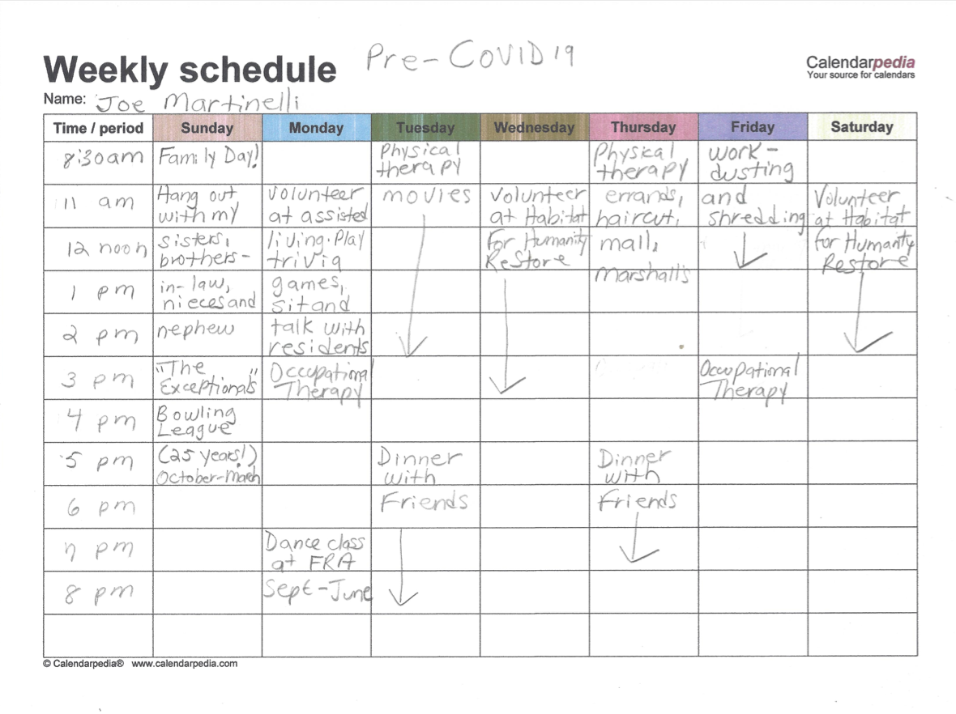
Joe’s Schedule
Before
COVID-19

Slide 23
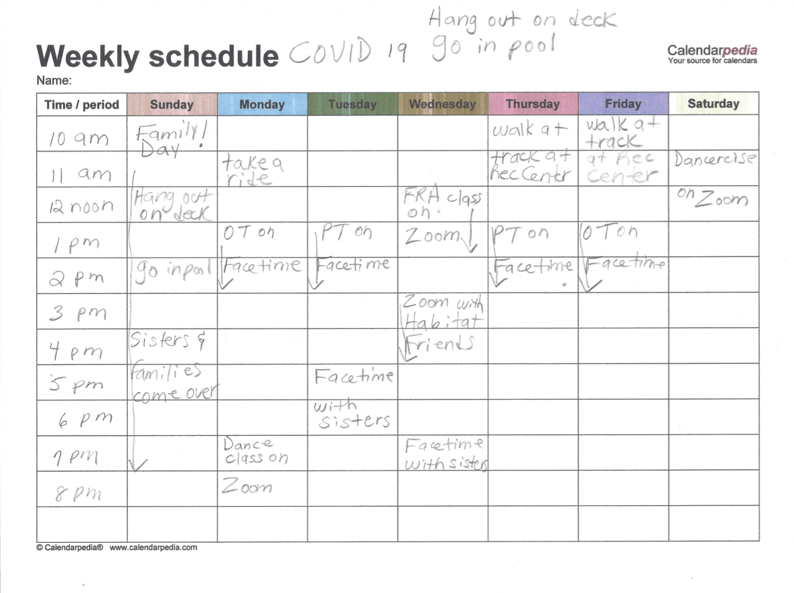
Joe’s Schedule
During
COVID-19

Slide 24
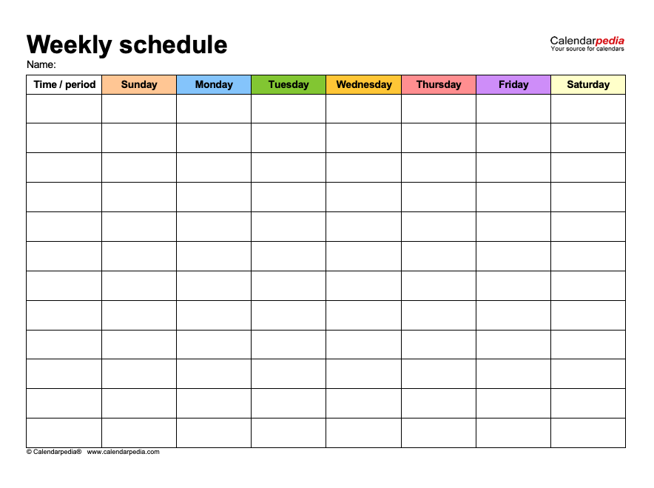
Joe’s Schedule
Looking
Toward the Future

Slide 25
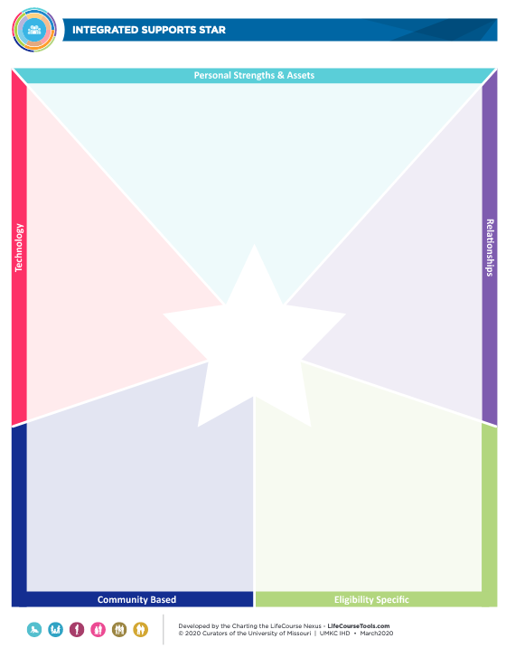
Integrated Supports Star
Identify resources and supports that can be used in everyday lives or for specific situations.
Employment
Social Life
Respite
Community Living
Supported Decision Making
Safety & Security
Health Living
Advocacy
Emergency/Crisis Situations
- UMKC IHC University of Missouri
https://www.lifecoursetools.com/integrated-stars/
Notes:
The Integrated Supports Star is another Charting the LifeCourse tool that can be extremely useful given the challenges that face us now. This tool is helpful for people with and without disabilities – but when it comes to identifying the variety of supports people with disabilities may need to be active, engaged and valued members of their communities this tool can be invaluable. This tool is used to help us to identify the resources and supports that can be used throughout our everyday lives or for specific situations, some of which are listed here. Examples of how they can be used for these situations can be found on the LifeCourse Tools website shown here. We’re going to spend time focus on the tool and brainstorming supports relevant to social distancing and maintaining connections and well-being.
<number>

Slide 26
What community-based activities and supports do people want to access more of once it’s safe?
- UMKC IHC University of Missouri
https://www.lifecoursetools.com/wp-content/uploads/CtLC-IntegratedSupportStar_2020.pdf
Notes:
<number>

Slide 27
How do people want to continue to use technology? What innovative ideas for using technology differently do you have?
- UMKC IHC University of Missouri
https://www.lifecoursetools.com/wp-content/uploads/CtLC-IntegratedSupportStar_2020.pdf
Notes:
<number>

Slide 28
COVID-19 Reimagining Questions and Input
???
Notes:
<number>

Slide 30
Richard West Assistive Technology Advocacy Center (ATAC) AT4NJ.org
ATAC NJ
Notes:
<number>

Slide 31
Upcoming Schedule:
Children’s Focused Town Halls
July 9 @ 7:00pm
July 16 @ 7:00pm
Register
https://www.drnj-covid.org/upcoming-events
Email Your Questions:
Questions@drnj.org

