Slide 1
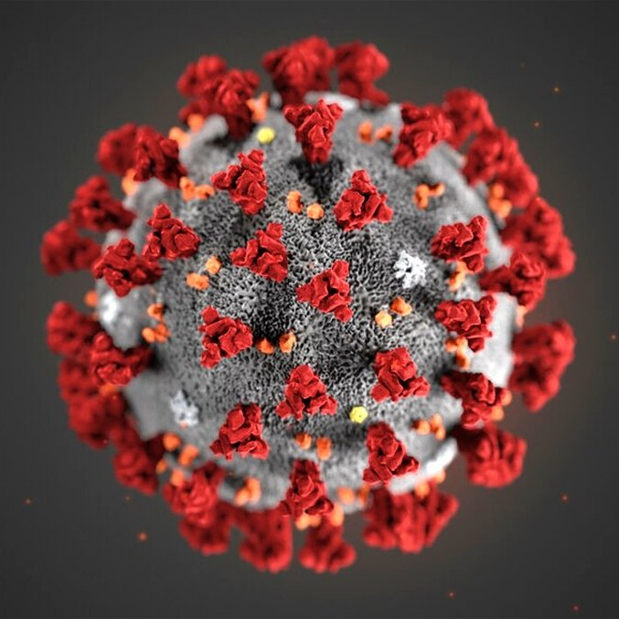
NJ AIDD Network Virtual Town Hall Convening the DD Community in the time of COVID-19 5/28/20
Notes:
Please join Disability Rights New Jersey and our Developmental Disabilities Network partners, The New Jersey Council on Developmental Disabilities and the Elizabeth M. Boggs Center on Developmental Disabilities, along with invited guests from the Office of the Ombudsman for Individuals with Developmental Disabilities and their families, as we host a virtual listening session this Thursday April 2 from 7pm-8pm.
We are offering this as an opportunity for individuals and family members to connect with us and one another, and promote the sharing of resources, information, and experiences. We will also provide brief updates on the continued work of our agencies in these constantly changing times.
You may send questions in advance to questions@drnj.org. (Please note that this email is specifically for questions/comments for our listening session. Any priority issues that would normally go through our intake process should still be directed to advocate@drnj.org)
Registration:
Please Register via this Zoom link. Only the first 100 participants will be able to access the live event but we will record the session and provide access to everyone who registers after the event.

Slide 2
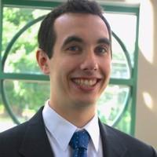
Our Facilitator
Michael Brower
Supervising Attorney
Community Inclusion Team
Notes:
Short link
Kick off to Gwen
<number>

Slide 3
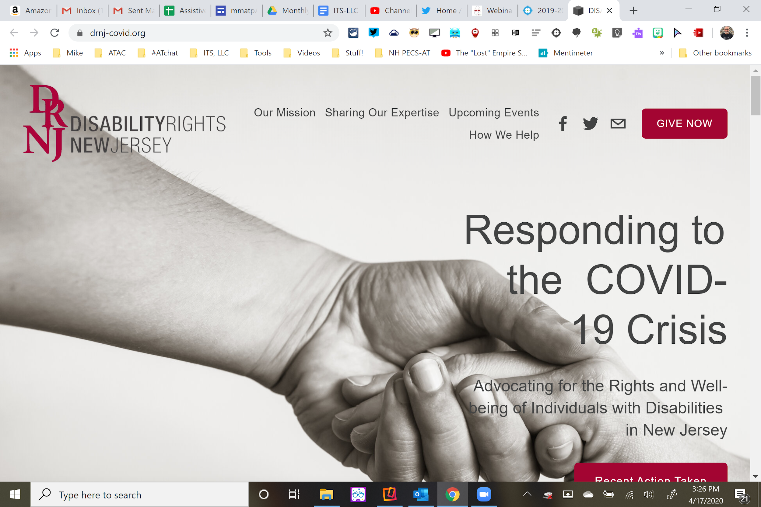
DRNJ-COVID.ORG

Slide 4
Welcome to our guest!
Assistant Commissioner Mollie Greene
Department of Children and Families
Children’s System of Care
Notes:
<number>

Slide 5
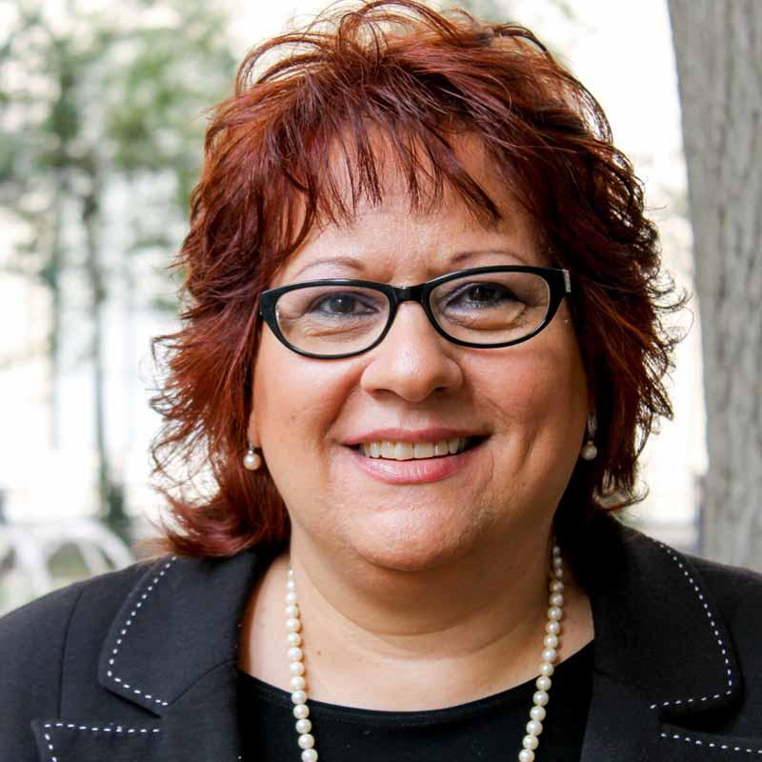
Mercedes Witowsky
Executive Director
njcdd@njcdd.org
Advocate
Collaborate
Educate
Notes:
Introduce your self and your role at the Council
<number>

Slide 6
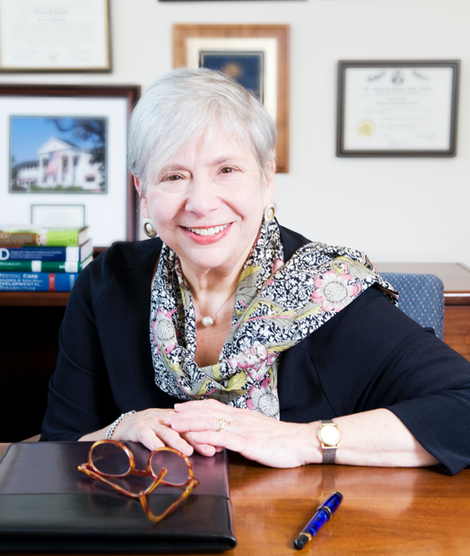
The Boggs Center on Developmental Disabilities
Deborah M. Spitalnik, PhD
Professor of Pediatrics
Professor of Family and Community Medicine
Executive Director
NJLEND Director

Slide 7
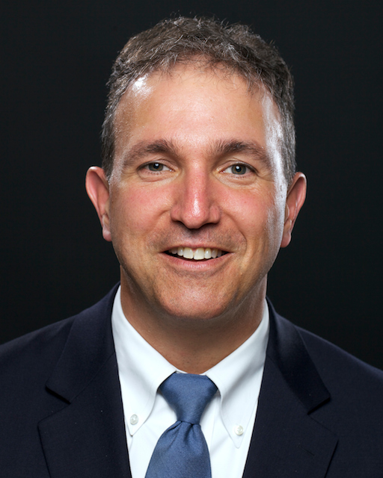
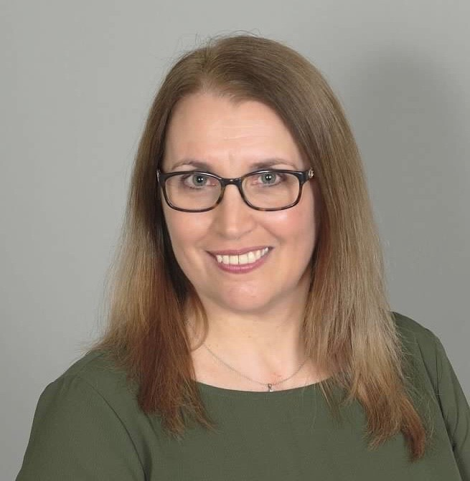
Office of the Ombudsman for Individuals with Intellectual or Developmental Disabilities and Their Families
Paul Aronsohn Christine Bakter
Ombudsman Associate Director
paul.aronsohn@treas.nj.gov christine.bakter@treas.nj.gov
201.213.1811 (personal cell) 609.789.6022 (cell)

Slide 8
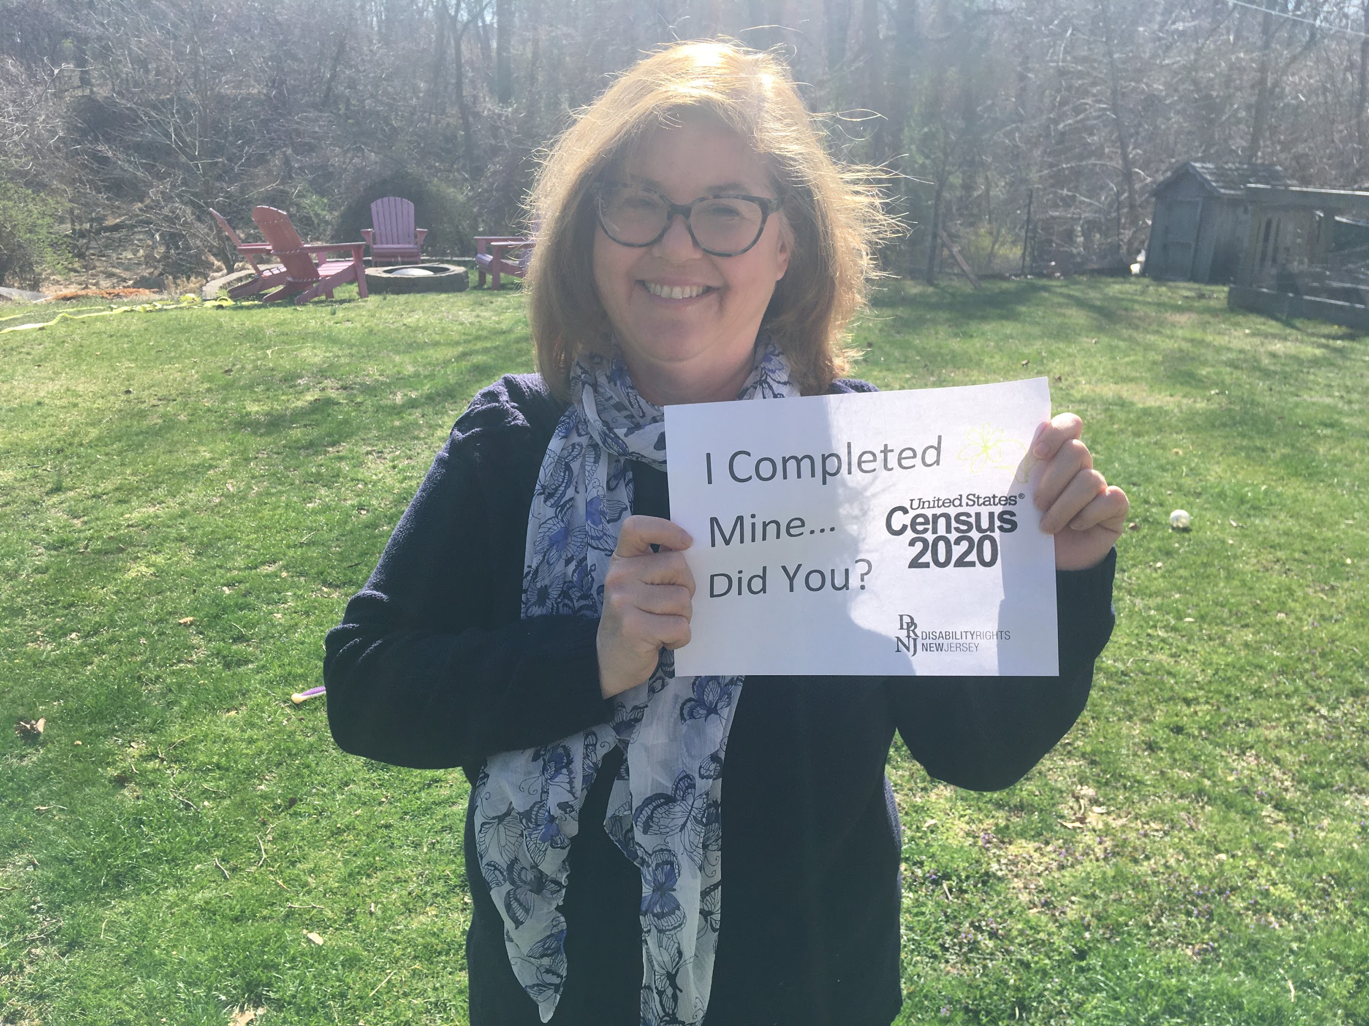
Gwen Orlowski
Executive Director
Contact Us:
210 South Broad Street, 3rd Floor
Trenton, New Jersey 08608
800-922-7233 (toll free in NJ only)
609-292-9742
609-777-0187 FAX or 609-633-7106 TTY
www.drnj.org

Slide 9
We want to hear from you!
Share questions in the Chat window

Slide 10
We want to hear from you!
Share questions via email
Email Your Questions:
Questions@drnj.org
Notes:
Add phone icon

Slide 11
Updates from the New Jersey Department of Children and Families, Division of Children’s System of Care
Notes:
Agenda
Intro all agencies
2 Focus Areas
1.Students under 21
What’s working?
What are your concerns?
Ideas / Strategies
Service Access
Continuity of Service
2. Adults over 21
Focus
Home and Community Based Services
Institutions

Slide 12
NEW JERSEY DEPARTMENT OF CHILDREN AND FAMILIES
Children’s System of Care
COVID-19 Response
Assistant Commissioner Mollie Greene
May 28, 2020
Notes:
Intro Static Page
<number>

Slide 13
Changes to CSOC service lines
Many community services can now be delivered by telehealth
OOH guidance provided to address admission policy, visitation and home passes
Respite
Summer Camp

Slide 14
CSOC monitoring and support to impacted OOH programs
Daily survey and follow-up
Positive, symptomatic and quarantined youth
Positive & symptomatic staff
Need for PPE (weekly)
Establishment of alternate sites
Proposal and implementation of testing protocols

Slide 15
Questions?

Slide 16
For more information…
Children’s System of Care:
http://www.state.nj.us/dcf/families/csc/
PerformCare Member Services:
877-652-7624
www.performcarenj.org
1
Notes:
<number>

Slide 18
Richard West Assistive Technology Advocacy Center (ATAC) AT4NJ.org
ATAC NJ
Notes:
<number>

Slide 19
Upcoming Schedule
TBD
Email Your Questions:
Questions@drnj.org

