Slide 1
NJ AIDD Network Virtual Town Hall Convening the DD Community in the time of COVID-19
Reopening and Reimagining Part III:
Reopening Schools – Factors to Consider
7/9/2020
Notes:
Please join Disability Rights New Jersey and our Developmental Disabilities Network partners, The New Jersey Council on Developmental Disabilities and the Elizabeth M. Boggs Center on Developmental Disabilities, along with invited guests from the Office of the Ombudsman for Individuals with Developmental Disabilities and their families, as we host a virtual listening session this Thursday April 2 from 7pm-8pm.
We are offering this as an opportunity for individuals and family members to connect with us and one another, and promote the sharing of resources, information, and experiences. We will also provide brief updates on the continued work of our agencies in these constantly changing times.
You may send questions in advance to questions@drnj.org. (Please note that this email is specifically for questions/comments for our listening session. Any priority issues that would normally go through our intake process should still be directed to advocate@drnj.org)
Registration:
Please Register via this Zoom link. Only the first 100 participants will be able to access the live event but we will record the session and provide access to everyone who registers after the event.

Slide 2
Sheltered Workshops Survey
Disability Rights New Jersey seeks information and experiences of workshop participants while COVID-19 caused workshops to be closed.
We encourage any workshop participants, family and workshop staff to share your thoughts and experiences while home and not attending workshops.
Contact us today at advocate@drnj.org
Notes:
Content Slide Option #3 – Use this slide for the content of your presentation. Duplicate as needed

Slide 3
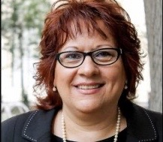
Mercedes Witowsky
Executive Director
njcdd@njcdd.org
Advocate
Collaborate
Educate
Notes:
Introduce your self and your role at the Council

Slide 4
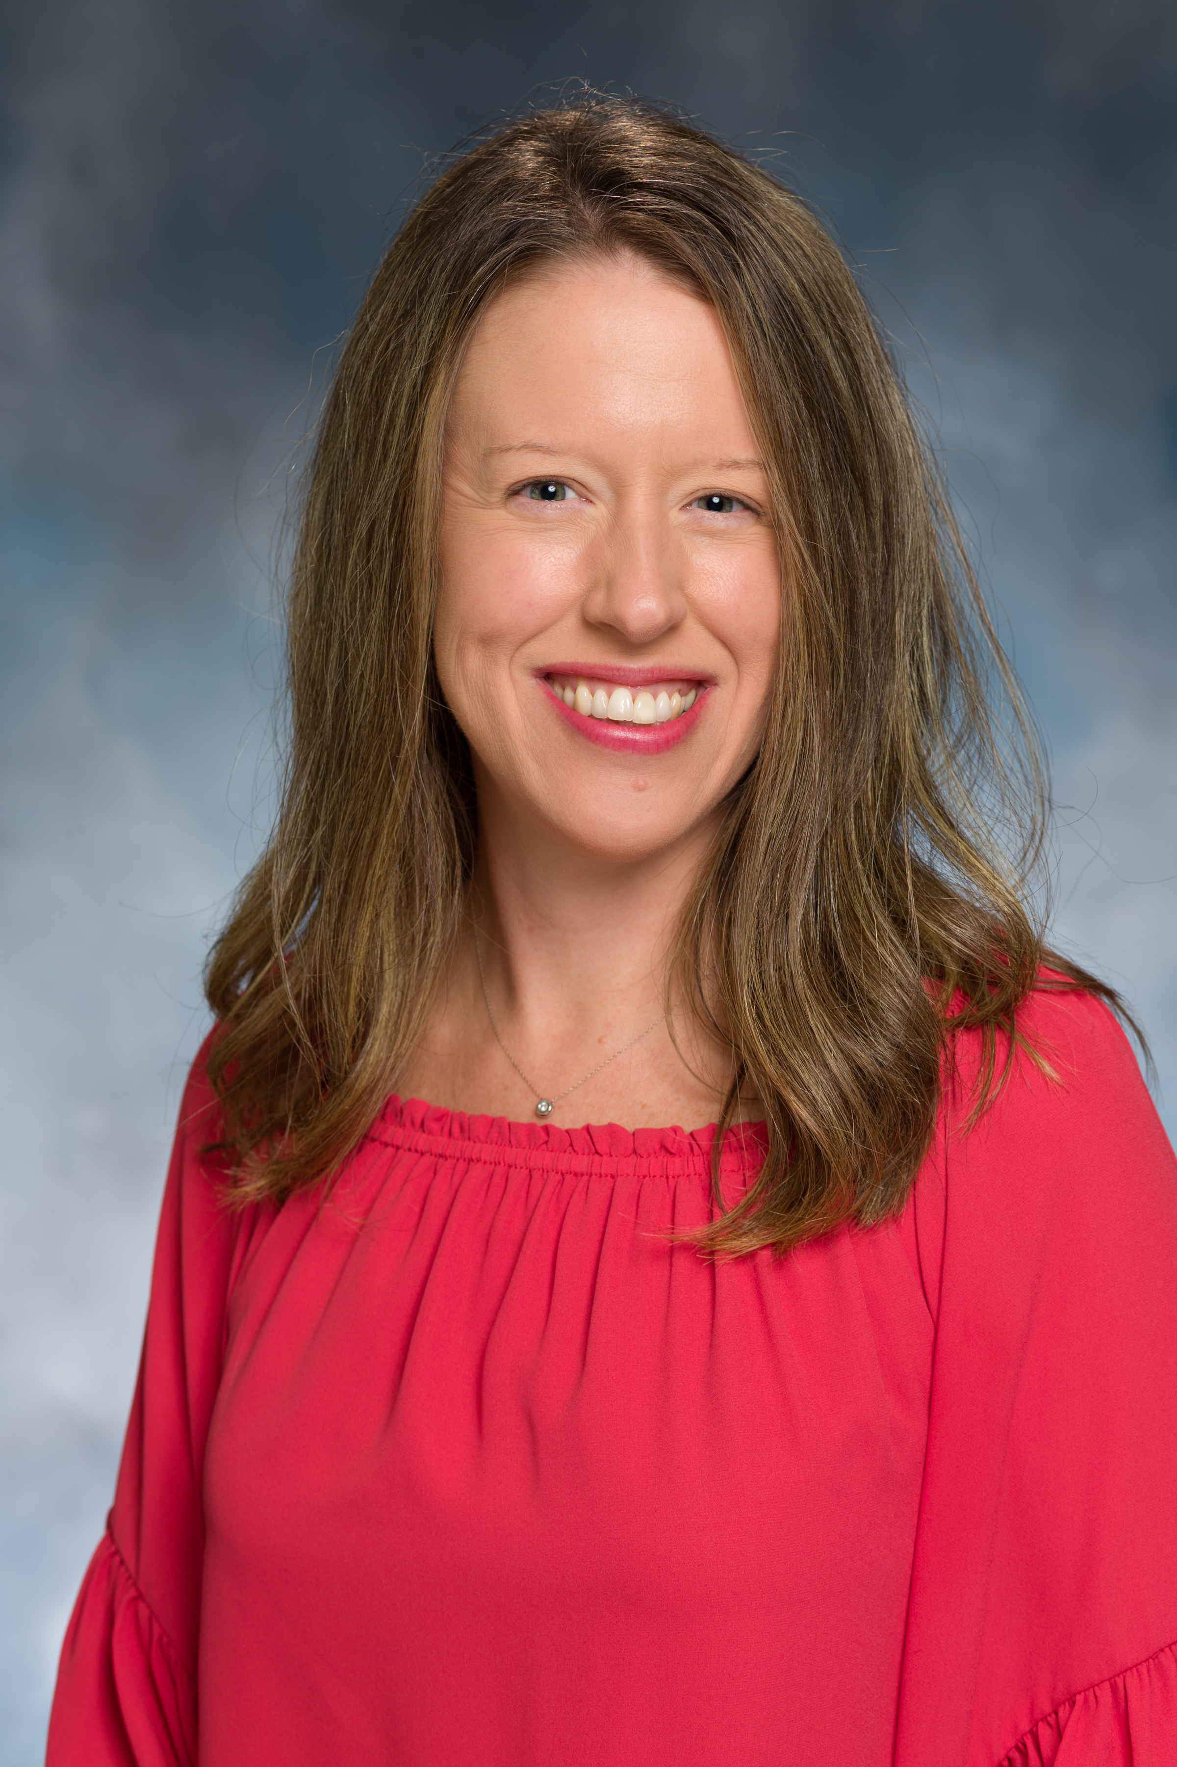
The Boggs Center on Developmental Disabilities
Colleen A. McLaughlin
Associate Director

Slide 5
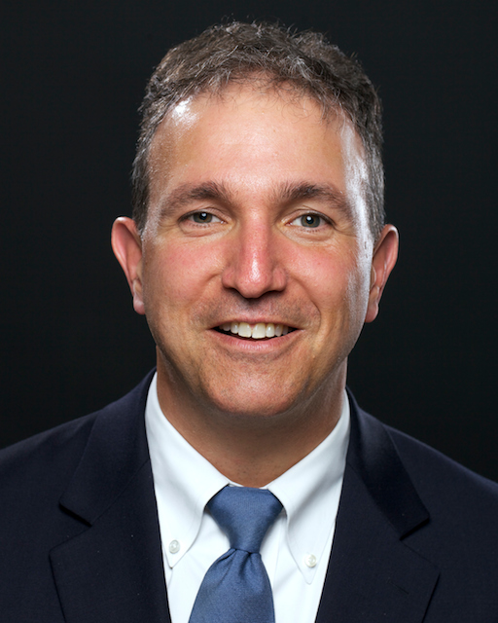
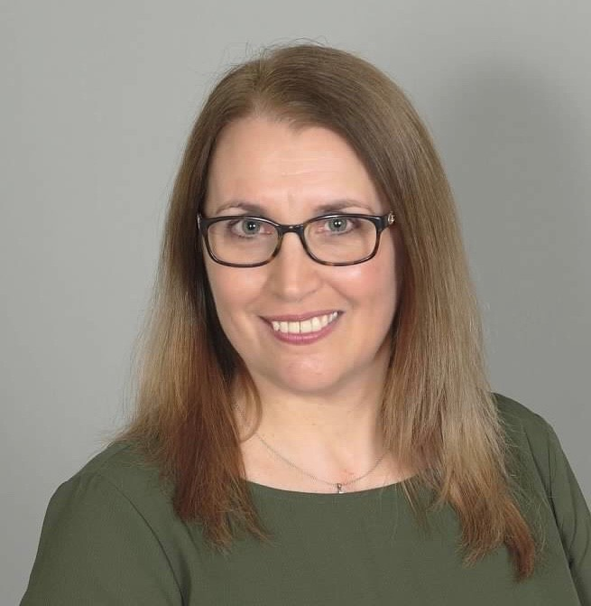
Office of the Ombudsman for Individuals with Intellectual or Developmental Disabilities and Their Families
Paul Aronsohn Christine Bakter
Ombudsman Associate Directorpaul.aronsohn@treas.nj.gov christine.bakter@treas.nj.gov 201.213.1811 (personal cell) 609.789.6022 (cell)

Slide 6
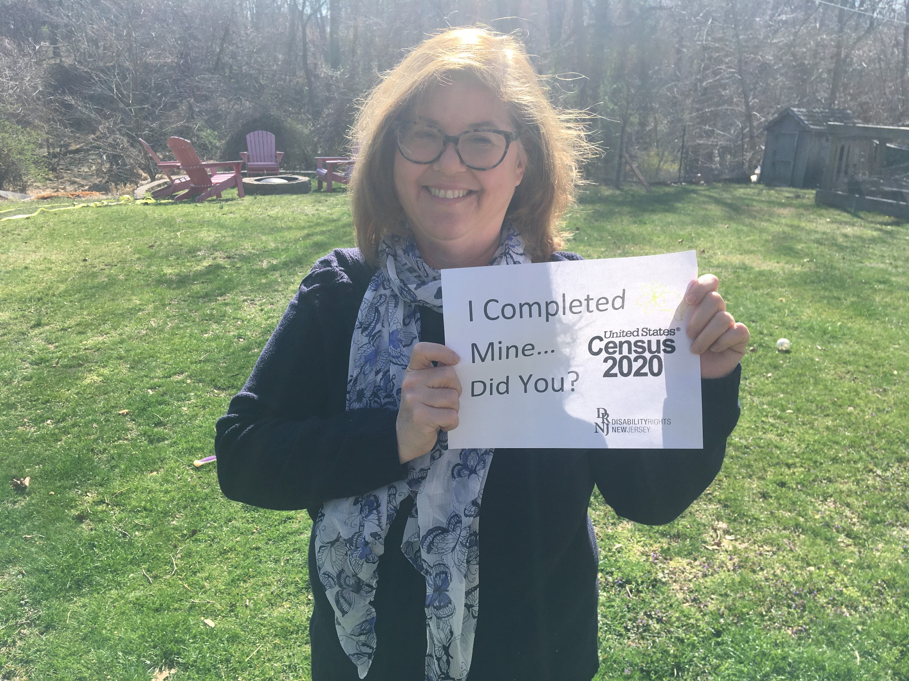
Contact Us:
210 South Broad Street, 3rd Floor
Trenton, New Jersey 08608
800-922-7233 (toll free in NJ only)
609-292-9742
609-777-0187 FAX or 609-633-7106 TTY
www.drnj.org
Gwen Orlowski
Executive Director

Slide 7
We want to hear from you!
Share questions in the Chat window

Slide 8
We want to hear from you!
Share questions via email or text!
Email or Text Your Questions:
Questions@drnj.org
Notes:
Add phone icon

Slide 9
Mercedes Witowsky
Executive Director
njcdd@njcdd.org
Advocate
Collaborate
Educate
Notes:
Introduce your self and your role at the Council

Slide 10
Reopening Children’s Services
The Road Back:
Restart and Recovery Plan for Education
New Jersey Department of Education
https://www.nj.gov/education/reopening/NJDOETheRoadBack.pdf
Early Intervention Services
DCF Children’s System of Care Services

Slide 11
COVID-19 Reopening Concerns
Health and Safety Concerns
Transportation
How do I plan? How do I return to my job?
Remote Learning
Food Services
Extracurricular Activity
Quality Child Care
Before and After School Care

Slide 12
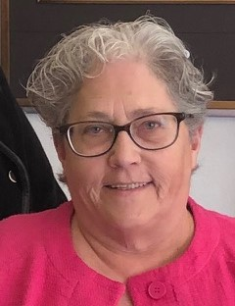
Reopening
Peg Kinsell
Institutional Policy Director at
SPAN Parent Advocacy Network
Co-directs the National RAISE (Resources for Access Independence Self-Advocacy Employment) Technical Assistance Center
As a veteran and former military spouse, Ms. Kinsell has a special expertise working with military families. She heads up the Military Family Support 360 Center at Joint Base McGuire -Dix-Lakehurst which supports military-connected children and youth with disabilities and special healthcare needs.

Slide 13
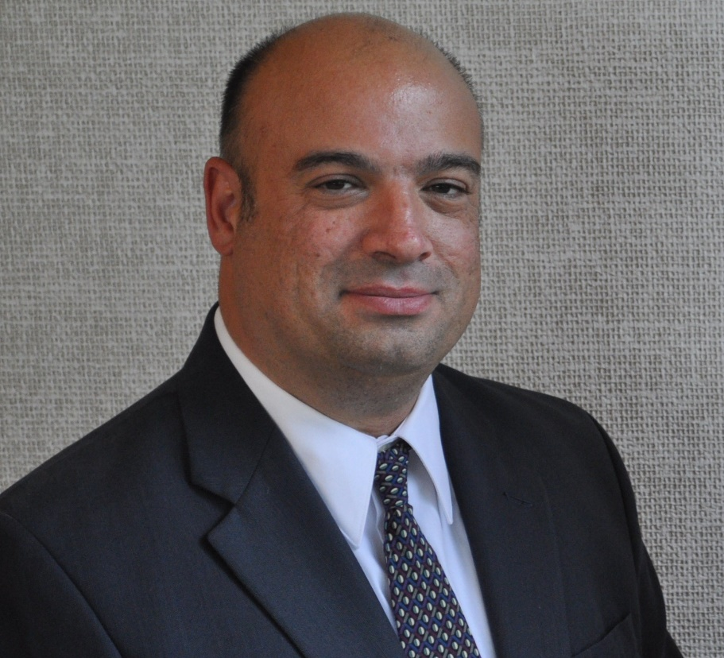
Family Advocate Perspective: Reopening
Scott Cohen
Parent of a 19 year old daughter who is differently abled
Partners in Policy Making Graduate 2017
Public HS Teacher
Chair of the Hunterdon HSAC
Vice Chair RFSPC #5

Slide 14
Real things you can do NOW while waiting for more guidance from the district/state
Go back and record on paper or online calendar the services provided during pandemic
What service (academic, counseling, OT, PT, Speech, pre-voc or vocational training)
How long
Was it live or did you watch a recording? Which delivery method was more effective?
What goals from the IEP were addressed during the pandemic?
If ESY is virtual – record services provided, and the goals addressed
Practice wearing masks. If you are seeing sensitivities or concerns, contact your case manager to start the discussion about health and safety measures + tips to prepare students
Can include a behavioral intervention or Physician recommendations
Notes:
Content Slide Option #3 – Use this slide for the content of your presentation. Duplicate as needed

Slide 15
Real things you can do NOW while waiting for more guidance from the district/state
Stick to a routine this summer
Consider behavioral/emotional health needs
Document changes in behavior or spikes in anxiety, depression, loss of social skills
Be sure to have these written down so you can share them with the IEP team and create a plan for addressing the concerns
Allow yourself grace to watch Frozen 2 for the tenth time
Remind yourself this system will not be perfect. The more you document, the more you can contribute to the conversation when school re-opens
Notes:
Content Slide Option #3 – Use this slide for the content of your presentation. Duplicate as needed

Slide 16
COVID-19 Reopening Questions/Concerns/Input
?!?!?!

Slide 18
Richard West Assistive Technology Advocacy Center (ATAC) AT4NJ.org
ATAC NJ

Slide 19
Upcoming Schedule:
Extended School Year and Compensatory Education
July 10 @ 12:00 PM
Part IV: Reimagining Special Education, Supports and Services
July 16 @ 7:00pm
Register
https://www.drnj-covid.org/upcoming-events
Email Your Questions:
Questions@drnj.org

