Slide 1
Alternatives to Guardianship
An Introduction to Supported Decision-Making
Disability Rights New Jersey

Slide 2
Hosts:
Amy Jedele, Resource & Development Director
Zinke McGeady, Family Mentor

Slide 3
Presented By:
Michael Brower, Esq.
Supervising Attorney
Disability Rights New Jersey
Jill Hoegel
Managing Advocate
Disability Rights New Jersey
Notes:
Add Presenters names & titles in Text Box

Slide 4
About Disability Rights New Jersey
Disability Rights New Jersey answers the calls of those in need, advocating for the rights of individuals with disabilities in our statewide community.
As New Jersey’s Protection and Advocacy agency, designated by the Governor and incorporated in 1994, it is our mission to preserve the human, civil, and legal rights of persons with disabilities, empowering equality through persistence, awareness and expertise.
Notes:
Text Box – Add any additional information about us pertinent to your presentation or duplicate this slide and continue on the next

Slide 5
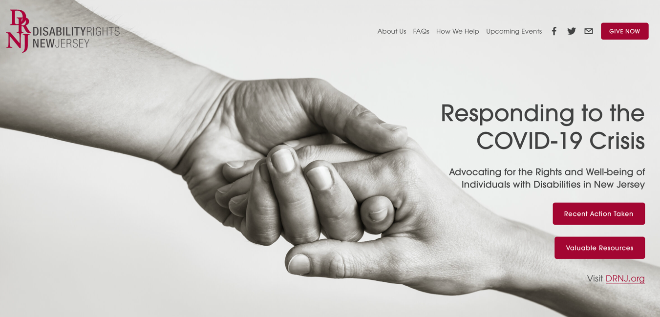
See our work at DRNJ-COVID.org

Slide 6
Our Purpose Today
Educate individuals, family members, and professionals about decision-making and guardianship from a disability rights perspective

Slide 7
Questions?
Please use the chat box for your questions

Slide 8
Topics of Discussion
What is Decision Making
Legal Frameworks
Supported Decision Making and Guardianships

Slide 9
“It is far better for a man to go wrong in freedom than to go right in chains.” -Thomas H. Huxley-
Individual autonomy is an idea that is generally understood to refer to the capacity to be one's own person, to live one's life according to reasons and motives that are taken as one's own and not the product of manipulative or distorting external forces, to be in this way independent.
What is a Decision?
Notes:
Quote slide – Use this slide to include an important quote as a reference or a statistic that is pertinent to your presentation.

Slide 10
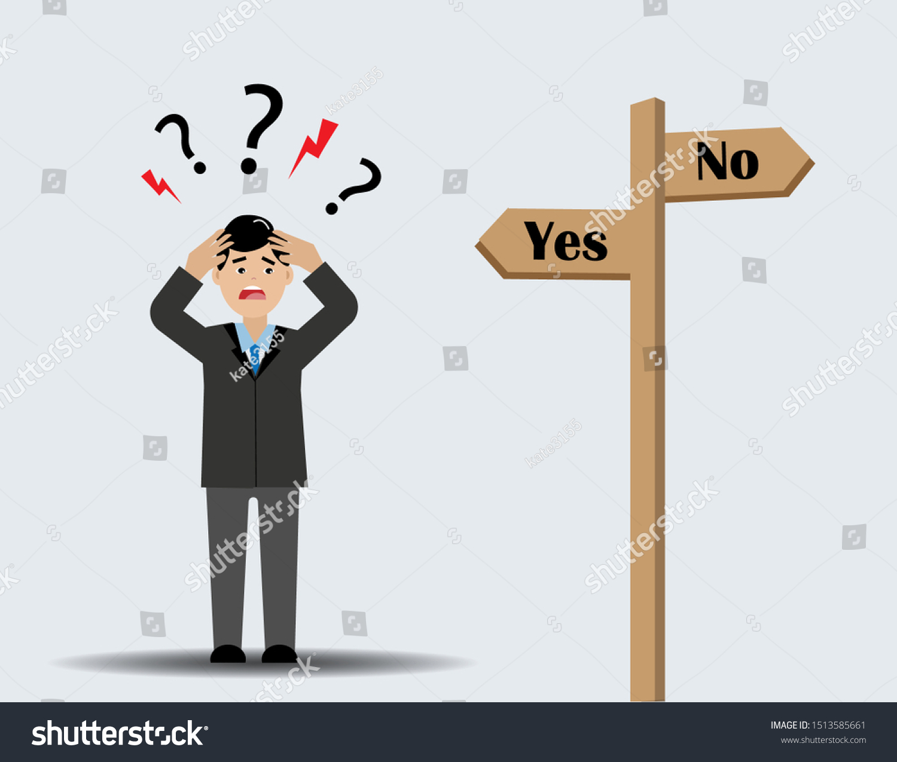
Decisions…Decisions…
Scenario: your car stalls on the highway while you are on a road trip
Scenario: your doctor gives you several options of treatment for dealing with an illness
Think about how many decisions you had to make today before joining us here
Notes:
Scenario: your car stalls on the highway while you are on a road trip.
-Decide to pull over, put on the flashers, call a tow truck?
-How do you know to do that?
-Tow truck brings you to the mechanic, how do you decide what to do? Do you speak with the mechanic, get an estimate for repair, maybe decide to scrap the car?
-Before you talked with the mechanic, were you competent to decide? Ran out of gas vs. transmission exploded.
-Even after hearing from the mechanic, might you call your brother? Your normal mechanic back home?
-Who is ultimately responsible to decide?
Maybe all those decision are just too overwhelming and you don’t make any of them. Deciding not to decide is still an exercise in decision making.
No matter how that came out, you probably just used supported decision making to respond to an unexpected problem. The same thing happens all the time, talking to doctors before a medical procedure, renting an apartment in a new state.
Sometimes, even with help, people without disabilities are allowed to make mistakes or decide without fully understand the risks. Renting in the wrong part of town, deciding to get that Nickelback tattoo, investing with Bernie Madoff.
Decision making isn’t all that different for people with cognitive disabilities (whether developmental, psychiatric, or brain-injury).
The difference might be how far into routine decisions support might be needed or how heavily the individual relies on support to make decisions.
Beware someone claiming to be a “supported decision-maker” for someone else.
Not going into any great depth on powers of attorney or healthcare proxies, which are formal appointment of agents to act on your behalf.

Slide 11
Topics of Discussion
What is Decision Making
Legal Frameworks
Supported Decision Making and Guardianships

Slide 12
New Jersey’s Framework for Supported Decision-Making
In New Jersey, there is no legal framework for supported decision-making
Individuals can craft ad-hoc supported decision-making arrangements to meet their specific needs.
Respecting an individual’s decision without the protection of a statute.
ADA Title III requires reasonable accommodations from businesses, doctor’s offices, hospitals, and other places of public accommodation.
NJ LAD similarly prohibits discrimination against people with disabilities in places of public accommodation.
Would a doctor be liable under ADA or LAD for refusing to treat a patient because of the patient’s disability?
Notes:
New Jersey does not have a SDM statutory or regulatory framework.
That being said, we are not in the wild west. The ADA and LAD require accommodations.
Under the ADA, LAD, or even some non-discrimination provisions in the ACA, could a doctor incur liability for refusing to treat a patient with cognitive disabilities? What accommodations would a doctor need to provide for someone who is deaf? Any different for intellectual disability?

Slide 13
Notes:
The rest of the world has something to say about this. Chapter 12 of the UN Convention on the Rights of Persons with Disabilities says that “State parties shall recognize that persons with disabilities enjoy legal capacity on an equal basis with others in all aspects of life”, this includes the right to support to exercise legal capacity.
The US signed the treaty, but the Senate has never ratified it so it does not have the force of law in the US.

Slide 14
Enter: Guardianship
“’Incapacitated individual’ means an individual who is impaired by reason of mental illness or intellectual disability to the extent that the individual lacks sufficient capacity to govern himself and manage his affairs.” N.J.S.A. 3B:1-2.
Courts may appoint a limited or general guardian after finding that in individual is incapacitated. N.J.S.A. 3B:12-24.1.
Courts should consider a limited guardianship before instituting a general guardianship. Matter of M.R., 135 N.J. 155, 171 (1994)
In a limited guardianship, the court must make specific findings about the areas where the individual retains legal capacity or where the guardian’s authority is limited. N.J.S.A. 3B:12-24.1(b).
Eg: Residential, educational, medical, legal, vocational, and financial decision-making.
Notes:
We do have, however, a guardianship statute and framework in New Jersey.
There are a few of the most important statutory excerpts up on the screen. Focus first on the standard for incapacity. “Lacking capacity to govern himself and manage his own affairs”.
This is a subjective standard, requires two doctors to certify.
We’ll talk more about M.R. later, but for now know that the law in NJ requires judges to consider whether a limited guardianship would suffice before a plenary guardianship, and to make findings specific to each domain of decision making. GIVE EXAMPLES FROM SLIDE

Slide 15
Guardianship for People Served by DDD
N.J. Court Rule 4:86-10(b)
Notes:
Remember when I said the standard was subjective and only required the certification of two doctors? Since 2016, the standard is even lower for adults who qualify for services from DDD.
For these guys, there only needs to be one physician or psychologist certification accompanied by a certification from an administrator of a DDD program, a DDD officer, a licensed care professional, or just a copy of an IEP from within the last two years.

Slide 16
Topics of Discussion
What is Decision Making
Legal Frameworks
Supported Decision Making and Guardianship

Slide 17
SDM as a Defense to Guardianship?
If an individual can manage their affairs with a supported decision making apparatus, are they incapacitated for purposes of N.J.S.A. 3B:1-2?
Notes:
What if someone had the capacity to designate a power of attorney or health care proxy? Are they capable of managing their own affairs?
Would the facts of a less restrictive supported decision making arrangement (formal or informal) be a good defense to incapacity?

Slide 18
Guardian’s Duty to Support Decision-Making
A guardian shall:
Find out and give due respect the preferences of the ward,
Encourage the ward to participate in the decision-making process to the most of his or her ability
Encourage the ward to act on his own behalf whenever he or she is able, and
Help the ward regain or develop decision-making capacity
N.J.S.A. 3B:12-57
Notes:
Supported decision-making does not go away if the court has judged someone to lack legal capacity. Without using the words “supported decision-making, New Jersey law clearly requires a guardian to engage the
incapacitated person in the decision-making process, respect their preferences, and help the ward learn to make decisions as much as possible.

Slide 19
Case Law Context: Reproductive Rights
In Re Grady
“The trial court should be reluctant to substitute its consent for any person who may be capable of making a decision for himself.” In re Grady, 85 N.J. 235 (1981).
In attempt to balance right of incapacitated person to be sterilized with right to be free from involuntary sterilization, courts must make a specific finding (supported by clear and convincing evidence) that the individual lacks the capacity to consent or withhold consent. Only then can “best interests” test be applied.
Notes:
There are some good cases in New Jersey that discuss the rights retained by people in guardianships, even if they are found to be generally incapacitated.
In Re Grady: Parents are the general guardian of their adult daughter who has Down syndrome. They want to let her be sexually active, but she can’t remember to use birth control. The hospital won’t perform the ligation without a court order.
Essentially, the hospital is saying that the guardians cannot consent to sterilization on behalf of their ward.
READ SECOND PARAGRAPH

Slide 20
Case Law Context: Self-determination
Matter of M.R.
“We are reminded also that the mere fact that a person is generally incompetent does not mean that person is incompetent for all purposes. A person who is generally incompetent can still make choices about specific matters.”
“We recognize the argument that as a decision increases in importance, so should the right of the affected person to make that decision. […]Our goal is to permit developmentally-disabled people to make as many decisions as possible, while protecting them from the harmful effects of bad decisions that they do not fully understand.” Matter of M.R., 135 N.J. 155, 169 (1994).
Notes:
If you read no other case, read M.R.
Facts: guardianship dispute between divorced parents of adult daughter. One fun parent, one structured parent.
M.R. had a preference for which parent she wanted to live with.
Building on Grady and the NJ constitution’s “inalienable right” to self-determination, the court finds READ SECOND PARAGRAPH.
Another holding regarding the burden of proof - Someone who wants to limit right to self-determination bears the burden of proving specific incapacity by clear and convincing evidence.

Slide 21
Takeaways from M.R.
Absent specific findings by the trial court, individuals subject to general guardianship retain fundamental rights of self-determination derived from the NJ Constitution.
Counsel for the alleged incapacitated person has a duty to zealously advocate for the individual’s subjective expressed interests short of the patently absurd or pose undue risks of harm. The guardian ad litem is responsible for reporting on objective best interests.
See N.J. Court Rule 4:86-7; NJRPC 1.14 for enforcement mechanisms
Notes:
READ PARAGRAPH 1 and 2.
Rule 4:86-7 contains enforcement mechanisms, which always allow the incapacitated person to request the court review the guardian’s actions or decisions, and to hire an attorney to help them fight for their expressed wishes.

Slide 22
Restoring Capacity
N.J.S.A. 3B:12-28, N.J. Court Rule 4:86-7
Notes:
Though relatively rare, individuals can be restored to legal capacity.
Mario Lemieux retired in 1997 after going through years of treatment for hodgkins lymphoma, a herniated disc, and chronic tendinitis. He made a comeback to the NHL in 2000 and played until 2005 with several MVP-level years, an olympic appearance for Team Canada, and one more close run for a Stanley Cup. The proof of his ability to come back and play top-tier hockey was in the results.
The same subjective test for incapacity is applied if an individual applies for restoration of capacity – two certifications for physicians stating that an individual is now “capable of governing himself and managing his own affairs”. This is usually the hardest part, finding two doctors willing to go out on a limb. The best proof for restoring capacity is going to be in the results- has the person demonstrated the ability to make decisions or enlist support when needed?

Slide 23
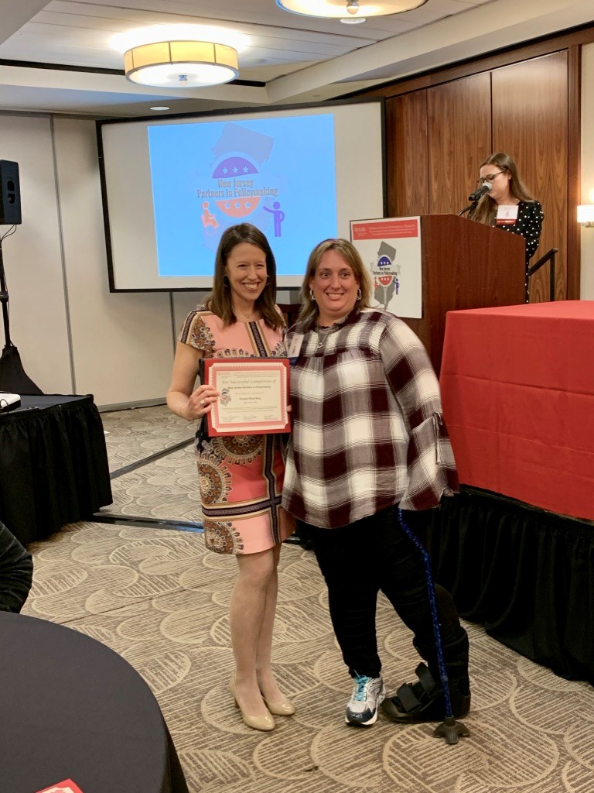
Pamela King: Self-Advocate
Pam King is her own Guardian who uses Supported Decision making to help make her life choices. She has supporters that she calls” Members of My Circle” that assist her with supported decision making.
Ms. King is a proud 2018 graduate of Partners in Policy Making.

Slide 24
Contact Us:
Disability Rights New Jersey
210 South Broad Street, 3rd Floor
Trenton, New Jersey 08608
800-922-7233 (toll free in NJ only)
609-292-9742
609-777-0187 FAX or 609-633-7106 TTY
advocate@drnj.org

Slide 25
Visit us online:
drnj.org
drnj-covid.org
@disabilityrightsnewjersey @advocateDRNJ

