Slide 1
Voting Rights in the Age of COVID-19 for Residents in Long Term Care Settings
Presented by:
The New Jersey Office of the State Long-Term Care Ombudsman;
Disability Rights NJ and
Center for Partnerships Transforming Health,
NJ Hospital Association
In partnership with:
New Jersey Department of Health
NJ Department of State, Division of Elections

Slide 2
Comprehensive Voting Guide Available LTCO/DRNJ
Basis of this webinar is Voting Information for Residents and Long Term Care Facilities (LTCO/DRNJ, October 2020)
Prepared with guidance from NJ Department of Health and Division of Elections
Emailed to facilities, long term care associations on October 6
Available on LTCO website: https://www.nj.gov/ooie/div-assets/docs/LTCOvoting.pdf

Slide 3
Main Points
Voting rights in long-term care
2020 voting processes and deadlines
Making a plan in your facility (mail-in ballots and in-person voting)
Communicating with family and residents
Understanding voting rights and accommodations for people with disabilities

Slide 4
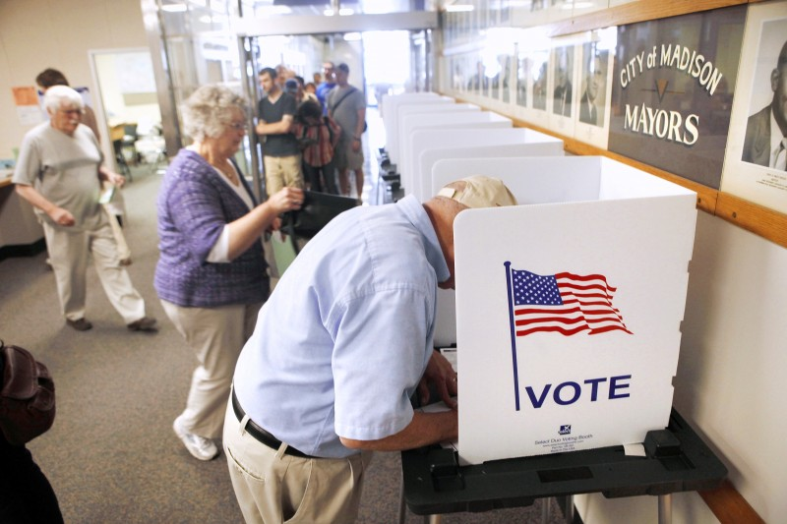
The Right to Vote in LTC
Fundamental Constitutional right
Federal and State LTC resident right
Living in LTC facility does not diminish, but enhances this right!
Residents need support, not barriers.
Residents more dependent on facility staff this year (COVID, mail)
Facilities need to plan and communicate to maximize voting

Slide 5
NJ Voting Eligibility
U.S. citizen
Resident of county where registered
18 years old; and
A person not serving a sentence of incarceration as a result of a conviction of any indictable offense

Slide 6
Voter Registration
NJ deadline passed October 13th for November election but residents can still register to vote in future elections by visiting NJ Voter Information Portal – www.nj.gov/state/elections
Staff can help residents register
helper must provide their name, address, and the date they filled out the form for the applicant.
no limits to how many residents a staff member can assist in this way.
Residents can check registration status online: https://voter.svrs.nj.gov/registration-check

Slide 7
Mail-in Ballot Process
All NJ counties required to mail ballots automatically to every active registered NJ voter by October 5th
Ballots should have already arrived
Mailed to registration address – could be family home
Residents who are registered but who didn’t receive a ballot can request one from County Clerk until October 23, 2020.
Residents must complete ballot (with assistance, if needed) and return in official pre-paid envelope.
read instructions carefully before completing
signature must match voter registration. Non-matching signatures will trigger a form to “cure” the mismatch and voter must return the form by November 22 for their vote to count.

Slide 8
Helping Residents Complete Ballots
The resident’s vote is always their choice – no one else’s.
Anyone can help – staff, family, friends, etc. – but resident must sign the voter certification. Anyone who helps a resident must fill out “assistor” section on front of inside envelope.
Family, friends, etc. can help residents during approved visits (outdoor, Essential Caregiver, Compassionate Care, indoor) pursuant to latest DOH guidance [DOH Directive 20-026 as of 10/08]. Facility should encourage/facilitate family involvement where desired.
Assistor can help unlimited number of residents.

Slide 9
How/When to Submit Mail-in Ballots
Ballots sent via mail must be postmarked by Nov. 3 and received by the county election board by Nov. 10.
Ballots can be dropped in secure ballot drop boxes (there will be at least 10 per county) or the voter may take their own ballot to polling stations on Election Day.
If a resident wants another person (a “bearer”) to deliver their ballot for them, the bearer can carry no more than 3 ballots per election and must complete, in the voter’s presence, the bearer portion on the envelope of the voter’s ballot.
Long-Term Care Ombudsman strongly recommends residents vote by mail and return ballots ASAP via facility’s regular mail process.

Slide 10
In-Person Voting
Everyone except for voters with disabilities will vote on provisional paper ballots at the polls. Only voters who cannot fill out a paper ballot due to a disability are allowed to vote on ADA accessible machines.
Facilities should not quarantine residents simply because they go out to vote; this should be based on resident’s exposure when voting.
There is at least 1 in-person polling place in all NJ municipalities. List available on NJ Voter Information Portal: https://nj.gov/state/elections/vote-polling-location.shtml.

Slide 11
Important Voting Dates 2020
Oct. 5 Mail-In Ballots sent to all NJ registered voters
Oct. 13 Voter registration deadline (online or postmarked paper form)
Oct. 23 Last day to request a Mail-in Ballot by mail if you did not receive one
Nov. 3 Election Day
Nov. 10 Last day for Board of Election to receive ballots postmarked by Nov. 3
Nov. 20 Certification of the results

Slide 12
Voter I.D. at the Polls
If a resident has voted in NJ before, they do not need to show ID. If voting for first time and did not submit ID w/ registration, they must provide.
Acceptable forms of I.D.:
NJ driver's license;
Military or government ID;
Student ID;
Employee ID;
Store membership card;
US passport; OR
Bank statement, car registration, government check or document, rent receipt, sample ballot, utility bill, or any other official document.

Slide 13
Resident Mental Capacity and Voting
Residents should be presumed capable of voting unless there is a court order explicitly removing their right to vote.
Many people with guardians in NJ retain their right to vote.
A dementia diagnosis does not remove a resident’s right to vote.
A power of attorney may not vote the individual’s ballot. Only a voter can decide their vote and sign the ballot themselves.

Slide 14
Resident Mental Capacity and Voting
Facilities should not administer competency tests to determine whether residents with diminished capacity are “allowed” to vote. If a person can express a choice, they can vote.
Ex. “I want to vote for the woman candidate” (where there is only one) or “I always vote Republican and want to vote that way.”
vs. If a person cannot express any real choice, staff should not help them complete their ballot. (ex. A resident who repeats “George Washington”)

Slide 15
How Can Facilities Help Residents Vote?
Designate staff for voting
Communicate to residents and families
Assess Resident Needs
Schedule
Plan Transportation to the Polls

Slide 16
Designate Facility Staff/Set Schedule
Put voting dates and deadlines on the calendar now.
Figure out who will do what and when.
Activity directors, social workers, van drivers, managers, administrators and others can all help residents exercise their right to vote.

Slide 17
Communicate with Residents and Families
Communicate your plan to residents and families:
Get residents excited about voting!
Which staff members will assist with what aspects
When/how families can assist with mail-in voting
Plans, rules, and expectations re leaving facility to vote in-person
Distribute LTCO/DRNJ voting guidance to interested res/families

Slide 18
Assess Resident Needs
Identify residents who are not registered.
Identify and help residents who need ID.
Find out which residents need help with registration or ballots.
Figure out which residents have family support to fill out ballots and which do not.
Determine which residents wish to vote in person.

Slide 19
Transportation to the Polls
Plan this well in advance and train facility staff as needed.
Ensure vehicle drivers (e.g., buses, vans) practice all safety actions and protocols for other staff (e.g., hand hygiene, masks).
Reduce vehicle capacity to allow social distancing (i.e. one person seated per row, skipping a row between).
Onboard back to front and exit front to back.
Open windows if possible/safe to increase circulation of outdoor air.
Clean and disinfect vehicle between trips (if multiple per day)
Follow CDC guidance for bus transit operators for cleaning/disinfection.

Slide 20
Other Relevant Guides/Resources
Helping Residents Vote in 2020, the American Health Care Association and National Center for Assisted Living (2020): https://www.ahcancal.org/News-and-Communications/Blog/Pages/Helping-Residents-Vote-in-2020.aspx
Assisting Cognitively Impaired Individuals with Voting: A Quick Guide, The American Bar Association on Law and Aging and the Penn Memory Center (2020): https://www.americanbar.org/content/dam/aba/administrative/law_aging/2020-voting-guide.pdf
Voting – It’s Your Right, The Boggs Center on Developmental Disabilities and DRNJ (2016): http://www.drnj.org/pdf/VotingGuide-ENG-Rev2016-04-FINAL.pdf.

Slide 21
Contacts for LTC Questions/Concerns
The Long Term Care Ombudsman’s Office – 877-582-6995 www.nj.gov/ltco
Disability Rights NJ – 800-922-7233 www.drnj.org
County Boards of Election https://www.state.nj.us/state/elections/vote-county-election-officials.shtml

